Slide 1
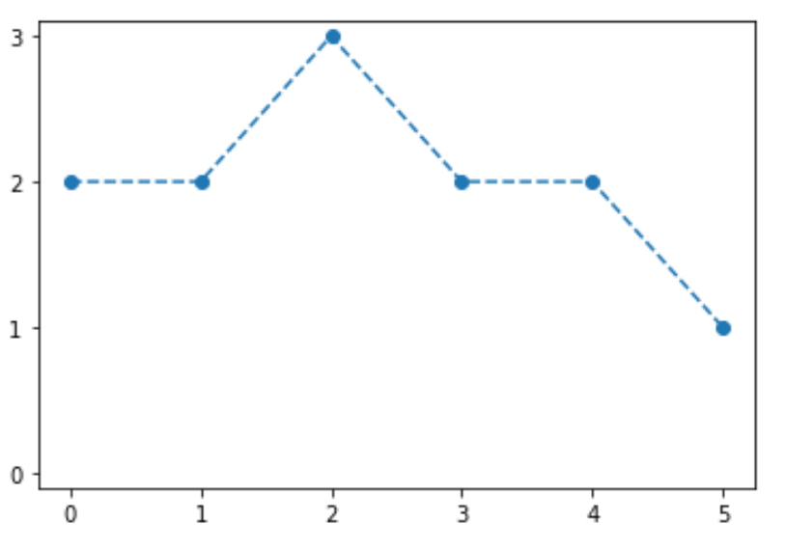
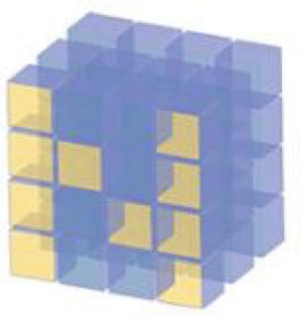
Markov Chain

Slide 2
Reference
Youtube
Code

Slide 3

State

Slide 4
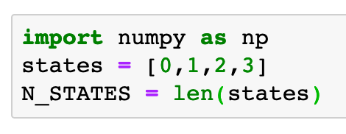
0
1
2
3

Slide 5

Transition Probability

Slide 6
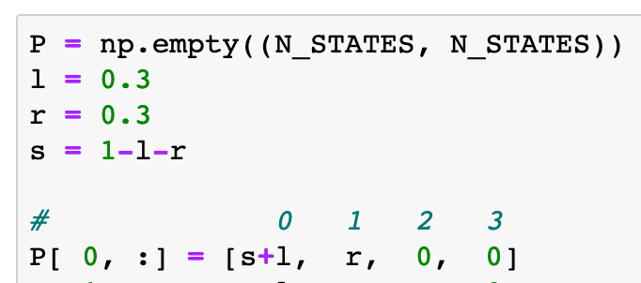
0
1
2
3
0.3
0.7

Slide 7
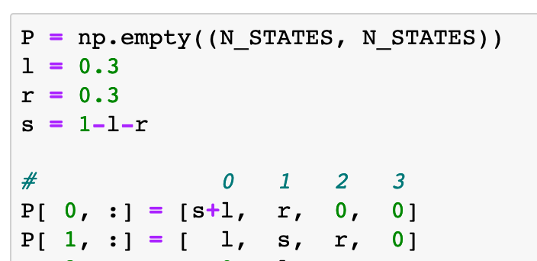
0.3
0.3
0
1
2
3
0.3
0.7
0.4

Slide 8
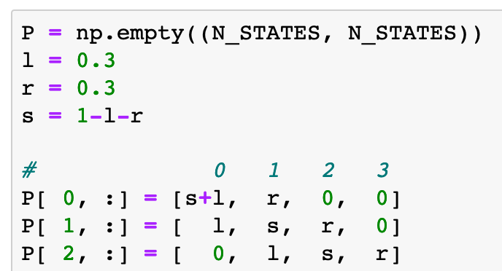
0.3
0.3
0
1
2
3
0.3
0.3
0.3
0.7
0.4
0.4

Slide 9
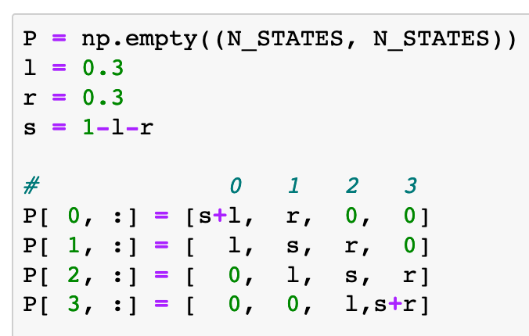
0.3
0.3
0.3
0
1
2
3
0.3
0.3
0.3
0.7
0.4
0.4
0.7

Slide 10
Initial State

Slide 11
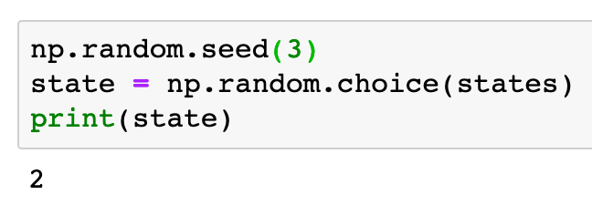
2

Slide 12
Simulation

Slide 13
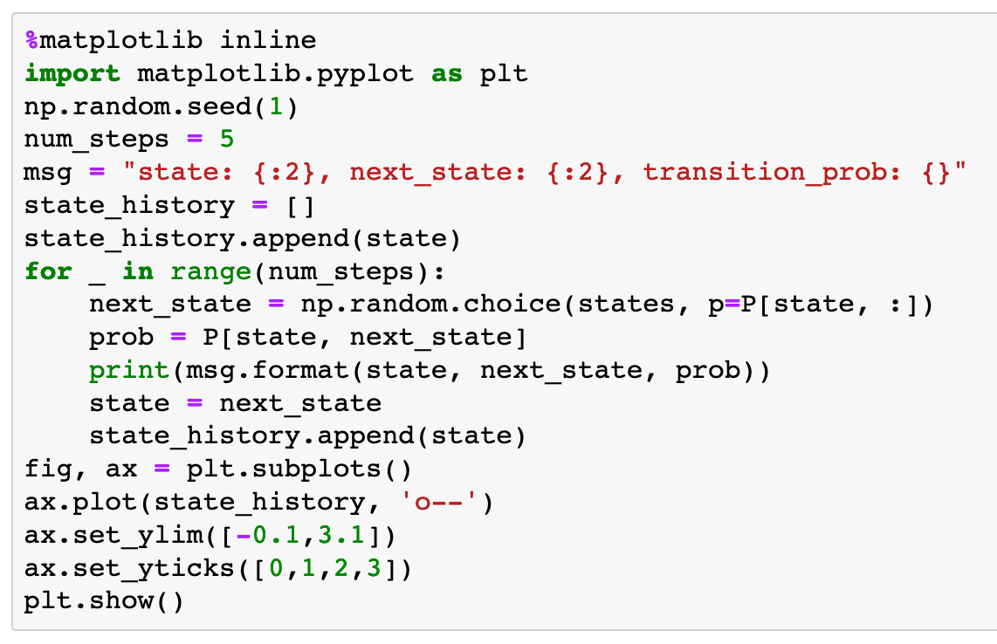
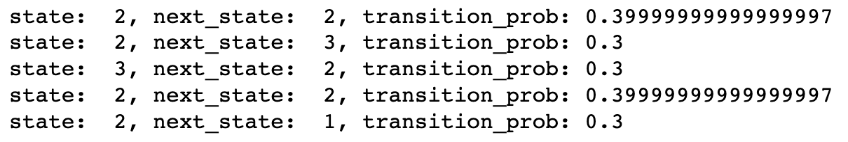

Slide 14
set maximum simulation steps

Slide 15
set maximum simulation steps

Slide 16
Message Format Setup

Slide 17
Message Format Setup
Current State

Slide 18
Message Format Setup
Current State
Next State

Slide 19
Message Format Setup
Transition Probability
Current State
Next State

Slide 20
Message Format Setup
Printed Messages
Transition Probability
Current State
Next State

Slide 21
Create empty list to record visited states

Slide 22
Create empty list to record visited states
Append current state

Slide 23
Create empty list to record visited states
Append current state
Jump to next state

Slide 24
Create empty list to record visited states
Append current state
Jump to next state
Compute transition probability

Slide 25
Create empty list to record visited states
Append current state
Jump to next state
Compute transition probability
Update current state

Slide 26
Create empty list to record visited states
Append current state
Jump to next state
Compute transition probability
Update current state
Append current state

Slide 27
create fig and ax

Slide 28
create fig and ax
plot

Slide 29
create fig and ax
plot
set ylim

Slide 30
create fig and ax
plot
set ylim
set yticks

Slide 31
create fig and ax
plot
set ylim
set yticks
show

Slide 32
constructed figure
create fig and ax
plot
set ylim
set yticks
show

Slide 33
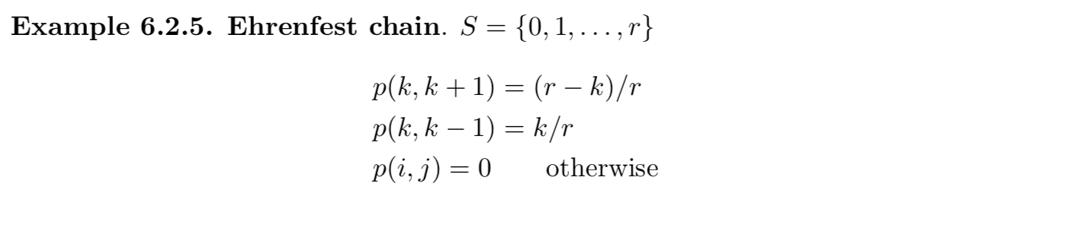
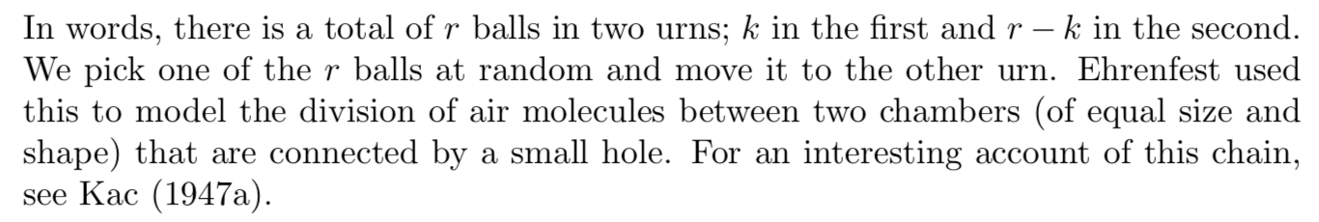
Exercise
Simulate the following Markov Chain from
Durrett
with r=5

Slide 34
Now
Let’s Play with Code

